Slide 1
Introduction To Algorithms
Divide And Conquer

Slide 2
Algorithm Design Techniques
Brute Force: Look at all possibilities
Divide-and-Conquer (Recursion): Divide the larger problem into subproblems and solve subproblems
Dynamic Programming: Recursive algorithms many time solve the same problem multiple times, Dynamic Programming allows to save the work and reuse when required
Greedy: Try to find the solution quickly by optimizing decision based on local information

Slide 3
Brute-Force Examples
int factorial(n):
fact := 1
for i := 1 to n do
fact := fact * i
return fact;
int power(m, n):
pow := m
for i := 1 to n-1 do
pow := pow * m
return pow;

Slide 4
Divide-and-Conquer (Recursion) Examples
int factorial(n):
if (n==1)
return 1
else
return n * factorial(n-1)
int power(n, m):
if (m==1)
return n
else
return n * power(n, m-1)
Implement recursive power algorithm

Slide 5
Why does it work?
factorial(4)
4 * factorial(3)
4 * (3 * factorial(2))
4 * (3 * (2 * factorial(1)))
4 * (3 * (2 * 1))
4 * (3 * 2)
4 * 6
24
Work out Recursive Power Solution:
power(2,4)
2 * factorial(2,3)
2 * (2 * factorial(2,2))
2 * (2 * (2 * factorial(2,1)))
2 * (2 * (2 * 2))
2 * (2 * 4)
2 * 8
16

Slide 6
Can recursion go on forever?
What if the argument is zero or negative?
E.g:
fact -1
= -1 * (fact -2)
= -1 * (-2 * (fact -3))
= -1 * (-2 * (-3 * (fact -4)))
= -1 * (-2 * (-3 * (-4 * (fact -5))))
...
As we can see n will never become 1 and hence recursion will go on infinitely
It is only defined (i.e., gets an answer) for positive arguments

Slide 7
Define Recursion
When an algorithm calls itself to solve subproblems until terminating condition or base case
For example, factorial(n) calls itself until with n=n, n=n-1, n=n-2 and so on until the base case of n=1 is reached
For example, power(n,m) calls itself until with m=m, m=m-1, m=m-2 and so on until the base case of m=1 is reached

Slide 8
What is Terminating Condition or Base Case?
factorial is defined for all positive integer arguments, n.
n could be 1 – the result is 1
factorial 1 = 1
This is known as the base case.
All other (positive integer) n are bigger than 1, and so we can subtract 1 from n only a finite number of times before reaching 1.
factorial n = n * factorial(n - 1)
This is known as the recursive case i.e. we solve subproblem factorial(n-1) to solve factorial(n)

Slide 9
Recursive Method
To be well defined it must:
Have a clearly identified range of arguments for which it is meant to work.
Have at least one base case, which does not cause a call to the same method.
In all recursive cases the arguments passed to a call of the same method, are nearer to a base case, than those given.

Slide 10
How does it work? Box Trace
Label each recursive call in the body of the recursive method
Represent each call to the method by a new box containing the method's local environment
Arguments
Local variables
placeholder for value returned by each recursive call from the current box
The return value of the method itself
Draw an arrow from box to box, where each represents another recursive call
Cross off boxes as methods return

Slide 11
Box Trace
Factorial Box Trace
n = 4
A: fact(n-1)=?
return 4 * ?
n = 3
A: fact(n-1)=?
return 3 * ?
n = 2
A: fact(n-1)=?
return 2 * ?
n = 1
return 1
n = 4
A: fact(n-1)=
return
n = 3
A: fact(n-1)=
return
n = 2
A: fact(n-1)=
return
n = 1
return
6
2
1
24
6
2

Slide 12
Exercises 1
// Consider code below which prints series 1 to n
// Precondition: n >= 0
public static void print_series(n) {
for(int i=0; i<n; i++)
System.out.print(i);
System.out.println()
}
Write recursive version of this code (without using any loops)

Slide 13
Exercises 2
// Consider code below
// precondition: x >= 0
public void mystery(int x)
{
if ((x / 10) != 0)
mystery(x / 10);
System.out.print(x % 10);
}
Draw Box Trace for mystery(487653).

Slide 14
Exercise 3
public static void identify(int a[], int i) {
static int m=999999;
if (i == ARR_SIZE)
return m;
else {
if (m > a[i])
m = a[i];
i++;
identify(a, i);
}
}
Briefly describe what is identify() achieving?

Slide 15
Binary Number System
Decimal number system (base 10) : digits 0-9
Decimal 153 = 1*10² + 5*10¹ + 3*10⁰
Decimal 59 = 5*10¹ + 9*0⁰
Binary number system (base 2): bits 0-1
Binary 111011 = 1*2⁵ + 1*2⁴ + 1*2³ + 0*2² + 1*2¹ + 1*2⁰ = 32+16+8+0+2+1=59
Convert Decimal TO Binary
 | Quotient (/) | Reminder (%)
59/2 | 29 | 1
29/2 | 14 | 1
14/2 | 7 | 0
7/2 | 3 | 1
3/2 | 1 | 1
1/1 | 0 | 1

Slide 16
Decimal to Binary Conversion
Write a method printBinary that accepts an integer and prints that number's representation in binary (base 2).
Ex: printBinary(7) prints 111
Ex: printBinary(12) prints 1100
Ex: printBinary(42) prints 101010
Write the method recursively and without using any loops.

Slide 17
Using Recursive Definition
What is the Base Case: What is/are easy smallest decimal numbers to print in binary?
0
1
We have two base case n==1 or n==0 ( i.e. n<2)
What is the recursive case: Can we express a larger number in terms of a smaller number(s)?

Slide 18
Recursive Case Analysis
Suppose we have some arbitrary integer N
What is (N / 2)'s binary representation?
What is (N % 2)'s binary representation?
Ex: N is 10010101011 (base 2)

Slide 19
printBinary solution1 – Only prints the bits
// Prints the given integer's binary representation.
// Precondition: n >= 0
public static void printBinary(int n) {
if (n < 2) {
// base case; same as base 10
System.out.println(n);
} else {
// recursive case; break number apart
printBinary(n / 2);
printBinary(n % 2);
}
}

Slide 20
printBinary solution2 – Prints Reassembled Bits
// Prints the given integer's binary representation.
// Precondition: n >= 0
static int sum=0;
static int printBinary(int n) {
if (n == 0) {
// base case; same as base 10
return sum;
} else {
// recursive case; break number apart
printBinary(n / 2);
sum = 10*sum + (n%2);
return sum;
} }

Slide 21
Binary Search Algorithm
In an ordered list of number (sorted array) find the, a given number x
BINARY-SEARCH (A, lo, hi, x)
if (lo > hi)
return FALSE
mid ← ⎣(lo+hi)/2⎦
if x = A[mid]
return TRUE
if ( x < A[mid] )
BINARY-SEARCH (A, lo, mid-1, x)
if ( x > A[mid] )
BINARY-SEARCH (A, mid+1, hi, x)
1
2
3
4
5
6
7
8
4
3
5
7
9
10
11
12
mid
lo
hi

Slide 22
Binary Search Algorithm – Example 1A
A[8] = {1, 2, 3, 4, 5, 7, 9, 11}
lo = 1 hi = 8 x = 7
1
2
3
4
5
6
7
8
1
2
3
4
5
7
9
11
mid = 4, lo = 5, hi = 8
5
6
7
8
1
2
3
4
5
7
9
11
mid = 6, A[mid] = x Found!

Slide 23
Binary Search Algorithm – Example 1B
A[8] = {1, 2, 3, 4, 5, 7, 9, 11}
lo = 1 hi = 8 x = 6
1
2
3
4
5
6
7
8
1
2
3
4
5
7
9
11
mid = 4, lo = 5, hi = 8
low
high
1
2
3
4
5
7
9
11
mid = 6, A[6] = 7, lo = 5, hi = 5
low
high
1
2
3
4
5
7
9
11
mid = 5, A[5] = 5, lo = 6, hi = 5
NOT FOUND!
1
2
3
4
5
7
9
11
high
low

Slide 24
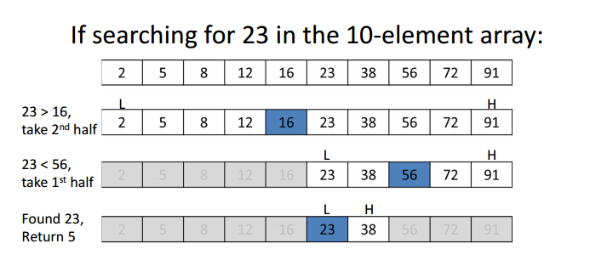
Binary Search Algorithm – Example 2
A[10] = {2, 5, 8, 12, 16, 23, 38, 56, 72, 91}
lo = 1 hi = 10 x = 23

Slide 25
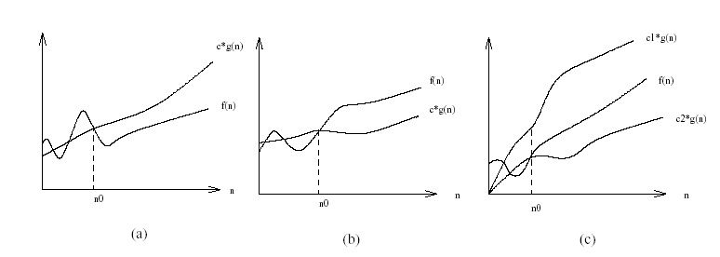
Recap of Big O, Big Ω and Big Θ
The definitions imply a constant n₀ beyond which they are satisfied. We do not care about small values of n.

Slide 26
Recurrences and Running Time
An equation or inequality that describes a function in terms of its value on smaller inputs.
T(n) = T(n-1) + n
Recurrences arise when an algorithm contains recursive calls to itself
What is the actual running time of the algorithm?
Need to solve the recurrence
Find an explicit formula of the expression
Bound the recurrence by an expression that involves n

Slide 27
Recurrence Examples with Runtimes
T(n) = T(n-1) + c Θ(n)
Recursive algorithm that iterates through each item by splitting the input into two parts, part 1 is one element and part 2 is n-1 elements and solving part 2 recursiely
T(n) = T(n-1) + n Θ(n²)
Recursive algorithm that loops through the input to eliminate one item
T(n) = T(n/2) + c Θ(lgn)
Recursive algorithm that halves the input in one step
T(n) = T(n/2) + n Θ(n)
Recursive algorithm that halves the input but must examine every item in the input
T(n) = 2T(n/2) + 1 Θ(n)
Recursive algorithm that splits the input into 2 halves and does a constant amount of other work

Slide 28
Analysis of Recursive Algorithms: factorial
int factorial(n):
if (n==1)
return 1
else
return n * factorial(n-1)
Total Time → T(n) = c + T(n-1) → Θ(n)
Where T(n-1) is the time it takes to solve subproblem with input n-1
Constant Time c
Subproblem of size n-1

Slide 29
Analysis of Recursive Algorithms: power
int power(m, n):
if (n==1)
return m
else
return m * power(m, n-1)
Total Time → T(n) = c + T(n-1) → Θ(n)
Where T(n-1) is the time it takes to solve subproblem with input n-1
Constant Time c
Subproblem of size n-1

Slide 30
Analysis of Recursive Algorithms: BINARY-SEARCH
BINARY-SEARCH (A, lo, hi, x)
if (lo > hi)
return FALSE
mid ← ⎣(lo+hi)/2⎦
if x = A[mid]
return TRUE
if ( x < A[mid] )
BINARY-SEARCH (A, lo, mid-1, x)
if ( x > A[mid] ) // if ( x < A[mid] ) OR if ( x > A[mid] )
BINARY-SEARCH (A, mid+1, hi, x)
T(n) = c1 + c2 + c3 + T(n/2) → c + T(n/2) → Θ(lg n)
Constant Time c1
Constant Time c2
Constant Time c3
Subproblem of size n/2
Subproblem of size n/2

Slide 31
Exercise
Analysis of Recursive Algorithms: printBinary
We have two solutions for printBinary.
Work out Recurrence equation for both solution 1 and solution 2.
Compare which solution is better? Why?

Slide 32
Solving Recurrence Equation

Slide 33
Methods for Solving Recurrences
Iteration Method
Substitution Method
Recurrence Tree Method
Master Method

Slide 34
Iteration Method
Convert the recurrence into a summation and try to bound it using known series
Iterate the recurrence until the initial condition is reached.
Use back-substitution to express the recurrence in terms of n and the initial (boundary) condition.

Slide 35
Iteration Method: Solve Recurrence for Factorial
T(n) = c + T(n-1) → T(n-1) = c + T(n-2)
T(n) = c + (c + T(n-2)) → substituting T(n-1), T(n-2) = c + T(n-3)
T(n) = c + (c + (c + T(n-3))) →
…
T(n) = c + c + c + … + c + c + T(2) → T(2) = c + T(1)
T(n) = c + c + c + … + c + c + c +T(1) → T(1) = c
T(n) = c + c + c + … + c + c + c + c = cn = Θ(n)
n-2 times
n-1 times
n times

Slide 36
Iteration Method: Solve Recurrence for Binary Search
T(n) = c + T(n/2) → T(n/2) = c + T(n/4)
T(n) = c + (c + T(n/4)) → substituting T(n/2), T(n/4) = c + T(n/8)
T(n) = c + (c + (c + T(n/8))) →
…
Assume n = 2^{k}, therefore k = (log₂ n) = (lgn)
T(n) = c + c + c + … + c + c + T(n/2^{k-1}) → T(n/2^{k-1}) = c + T(n/2^{k})
T(n) = c + c + c + … + c + c + c +T(n/2^{k}) → T(n/2^{k}) = T(n/n) = T(1) = c
T(n) = c + c + c + … + c + c + c + c = ck = Θ(lgn)
k-2 times
k-1 times
k times

Slide 37
Iteration Method: Solve Recurrence T(n) = n + 2T(n/2)
T(n) = n + 2T(n/2) → T(n/2) = n/2 + 2T(n/4)
T(n) = n + 2(n/2 + 2T(n/4)) = n + n + 4T(n/4) → substituting T(n/2), T(n/4) = n/4 + 2T(n/8)
T(n) = n + (n + 4(n/4 + 2T(n/8))) = n + n + n + 8T(n/8)
…
Assume n =, therefore k = (log₂ n) = (lg n)
T(n) = i*n + 2^{i}T(n/2^{i})
T(n) = k*n + 2^{k}T(n/2^{k}) = kn + 2^{k}T(n/n) = kn + 2^{k}T(1)
T(n) = = nlgn + nT(1) = Θ(nlgn)

Slide 38
Substitution Method
Guess a Solution
Use Induction to prove that solution works

Slide 39
Substitution Method
Guess a solution
T(n) = O(g(n))
Induction goal: apply the definition of the asymptotic notation
T(n) ≤ d g(n), for some d > 0 and n ≥ n0
Induction hypothesis: T(k) ≤ d g(k) for all k < n
Prove the induction goal
Use the induction hypothesis to find some values of the constants d and n0 for which the induction goal holds

Slide 40
Example: Binary Search
T(n) = c + T(n/2)
Guess: T(n) = O(lgn)
Induction goal: T(n) ≤ d lgn, for some d and n ≥ n₀
Induction hypothesis: T(n/2) ≤ d lg(n/2)
Proof of induction goal:
T(n) = T(n/2) + c ≤ d lg(n/2) + c
= d lgn – d + c ≤ d lgn
if: – d + c ≤ 0, d ≥ c
Base case?

Slide 41
Example 2:
T(n) = T(n-1) + n
Guess: T(n) = O(n²)
Induction goal: T(n) ≤ c n², for some c and n ≥ n₀
Induction hypothesis: T(n-1) ≤ c(n-1)² for all k < n
Proof of induction goal:
T(n) = T(n-1) + n ≤ c (n-1)² + n
= cn² – (2cn – c - n) ≤ cn²
if: 2cn – c – n ≥ 0 ⇔ c ≥ n/(2n-1) ⇔ c ≥ 1/(2 – 1/n)
For n ≥ 1 ⇒ 2 – 1/n ≥ 1 ⇒ any c ≥ 1 will work

Slide 42
Example 3:
T(n) = 2T(n/2) + n
Guess: T(n) = O(nlgn)
Induction goal: T(n) ≤ cn lgn, for some c and n ≥ n₀
Induction hypothesis: T(n/2) ≤ cn/2 lg(n/2)
Proof of induction goal:
T(n) = 2T(n/2) + n ≤ 2c (n/2)lg(n/2) + n
= cn lgn – cn + n ≤ cn lgn
if: - cn + n ≤ 0 ⇒ c ≥ 1
Base case?

Slide 43
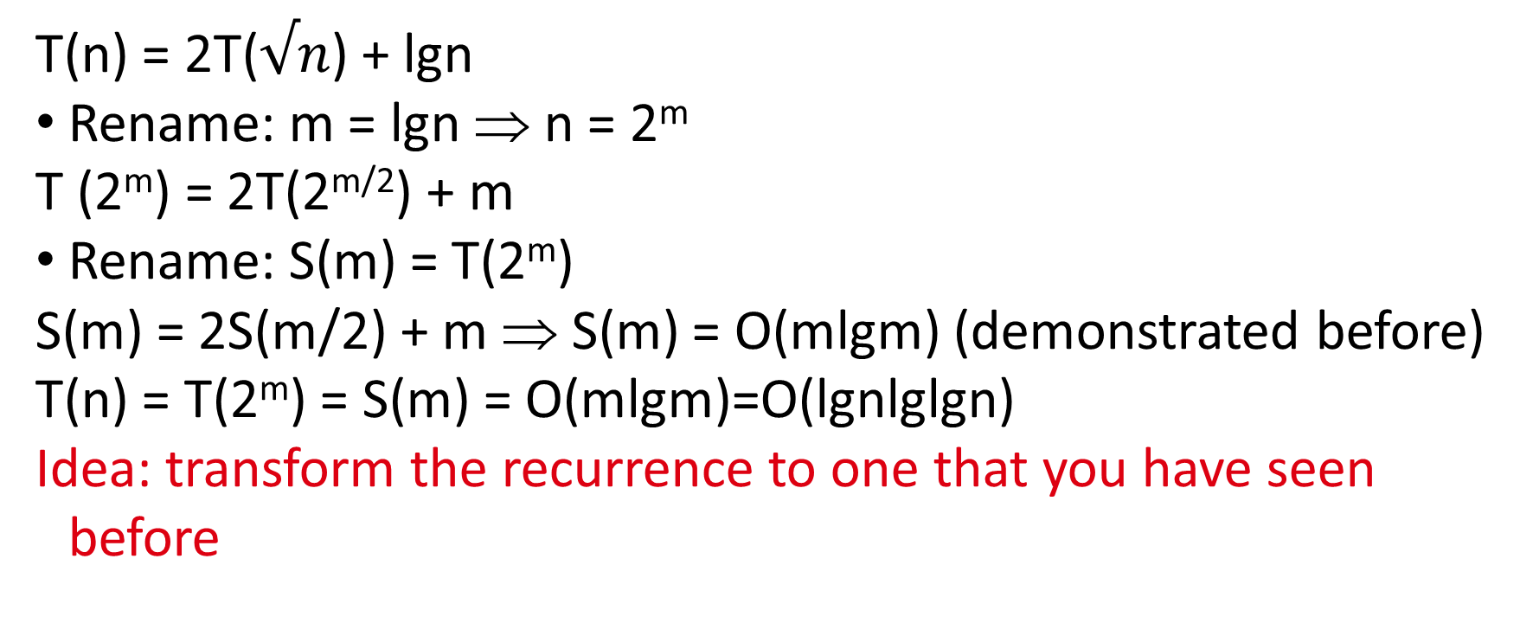
Changing Variables
T(n) = 2T($√n$) + lgn
Rename: m = lgn ⇒ n = 2^{m}
T (2^{m}) = 2T(2^{m/2}) + m
Rename: S(m) = T(2^{m})
S(m) = 2S(m/2) + m ⇒ S(m) = O(mlgm) (demonstrated before)
T(n) = T(2^{m}) = S(m) = O(mlgm)=O(lgnlglgn)
Idea: transform the recurrence to one that you have seen before

Slide 44
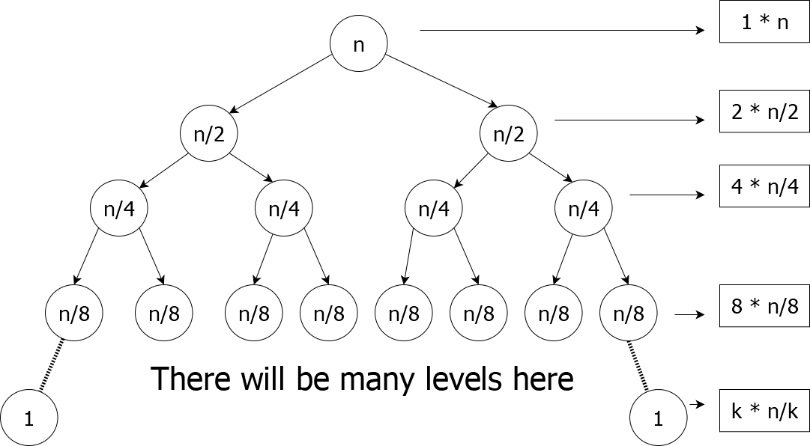
Recurrence Tree Method
T(n) = n + 2T(n/2)
T(n) = cost at each level * depth of the tree
Cost at each level = n, therefore,
T(n)=n*depth of tree
T(n)=Θ(nlgn)
Depth of the tree is k and k = lgn

Slide 45
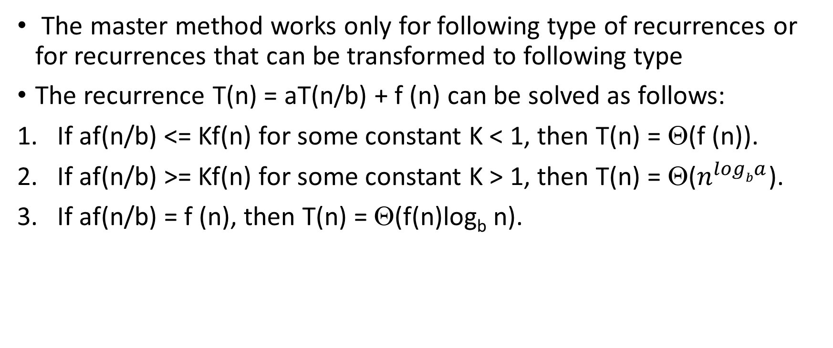
Master Method
The master method works only for following type of recurrences or for recurrences that can be transformed to following type
The recurrence T(n) = aT(n/b) + f (n) can be solved as follows:
If af(n/b) <= Kf(n) for some constant K < 1, then T(n) = Θ(f (n)).
If af(n/b) >= Kf(n) for some constant K > 1, then T(n) = Θ($n^{logba}$).
If af(n/b) = f (n), then T(n) = Θ(f(n)log_{b} n).

Slide 46
Master Method
T(n) = n + 2T(n/2)
If we consider T(n) = aT(n/b) + f (n) then
a=2, b=2 and f(n) = n
af(n/b) = 2(n/2) = n
This means af(n/b) = f(n)
In this case third condition is satisfied, therefore
T(n) = Θ(f(n)log_{b} a) = Θ (n log₂ n) = Θ (nlgn)

Slide 47
Master Method for Binary Search
T(n) = c + T(n/2)
If we consider T(n) = aT(n/b) + f (n) then
a=1, b=2 and f(n) = c
af(n/b) = c/2
This means af(n/b) = Kf(n)
In this case third condition is satisfied, therefore
T(n) = Θ(f(n)log_{b} a) = Θ (c log₂ n) = Θ (lgn)

Slide 48
Master Method Examples
T(n) = n + T(3n/4)
If we consider T(n) = aT(n/b) + f (n) then
a=1, b=4/3 and f(n) = n
af(n/b) = 3n/4
This means af(n/b) < f(n)
In this case first condition is satisfied, therefore
T(n) = Θ(f(n)) = Θ (n)

Slide 49
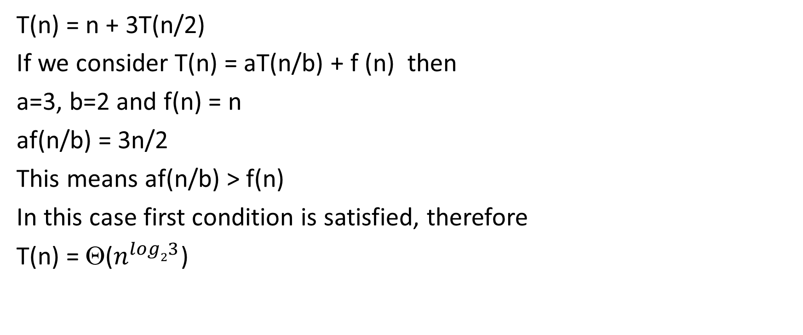
Master Method Examples
T(n) = n + 3T(n/2)
If we consider T(n) = aT(n/b) + f (n) then
a=3, b=2 and f(n) = n
af(n/b) = 3n/2
This means af(n/b) > f(n)
In this case first condition is satisfied, therefore
T(n) = Θ($n^{log23}$)

Slide 50
Master Method does not work for Some Recurrences
T(n) = nlgn + 2T(n/2)
If we consider T(n) = aT(n/b) + f (n) then
A=2, b=2 and f(n) = nlgn
af(n/b) = 2(n/2*lgn/2) = n(lgn – lg2) = nlgn – n
This means af(n/b) < Kf(n), so you would think of applying T(n) = Θ(f(n))
But remember highest order term of af(n/b) is same as f(n) therefore master theorem does not apply in this case.

Slide 51
Brute Force vs Divide-and-Conquer
For algorithms such as factorial(n), power(n,m), printBinary(n); Brute Force algorithm complexity will be same as complexity of divide-and-conquer
But many algorithms used for searching, sorting is where true power of divide-and-conquer algorithms is used.
For example, you can perform linear search which goes through each element of an array to find the value x which take T(n) = Θ(n) but if the array is sorted, we can use binary search instead which taken T(n) = Θ(lgn) time

